Slide 1
Developing External Tools for Power BI Desktop
Ted Pattison
Principal Program Manager
Power BI Customer Advisory Team (PBICAT)

Slide 2
Agenda
Developing External Tools for Power BI Desktop
Exploring Dev Camp External Tool Demo App
Programming the Tabular Object Model (TOM)
Adding Productivity Features to an External Tool
Extending Translations Builder

Slide 3
Developing an External Tool for Power BI Desktop
Power BI Desktop provides support for integrating external tools
External tool can be launched from Power BI Desktop
External tool designed to connect directly to dataset in local AS engine session
External tool can be designed to create, read, update and delete dataset objects
External tools are programmed using Tabular Object Model (TOM)
Local Desktop Setup on Windows PC
Your_External_Tool.exe
Power BI Desktop
Custom C# Code
Local Analysis Services Engine
Dataset
Tabular Object Model
localhost:55074
XMLA Endpoint
.NET 6 Runtime

Slide 4
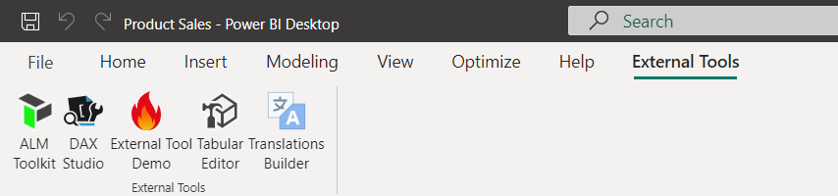
External Tools Integration with Power BI Desktop
Once installed, external tool becomes available through External Tools tab
Click on tile for external tool to launch it and connect to dataset
Popular External Tools available for free through Power BI Community
Tabular Editor 2
DAX Studio
ALM Toolkit
Translations Builder
Bravo

Slide 5
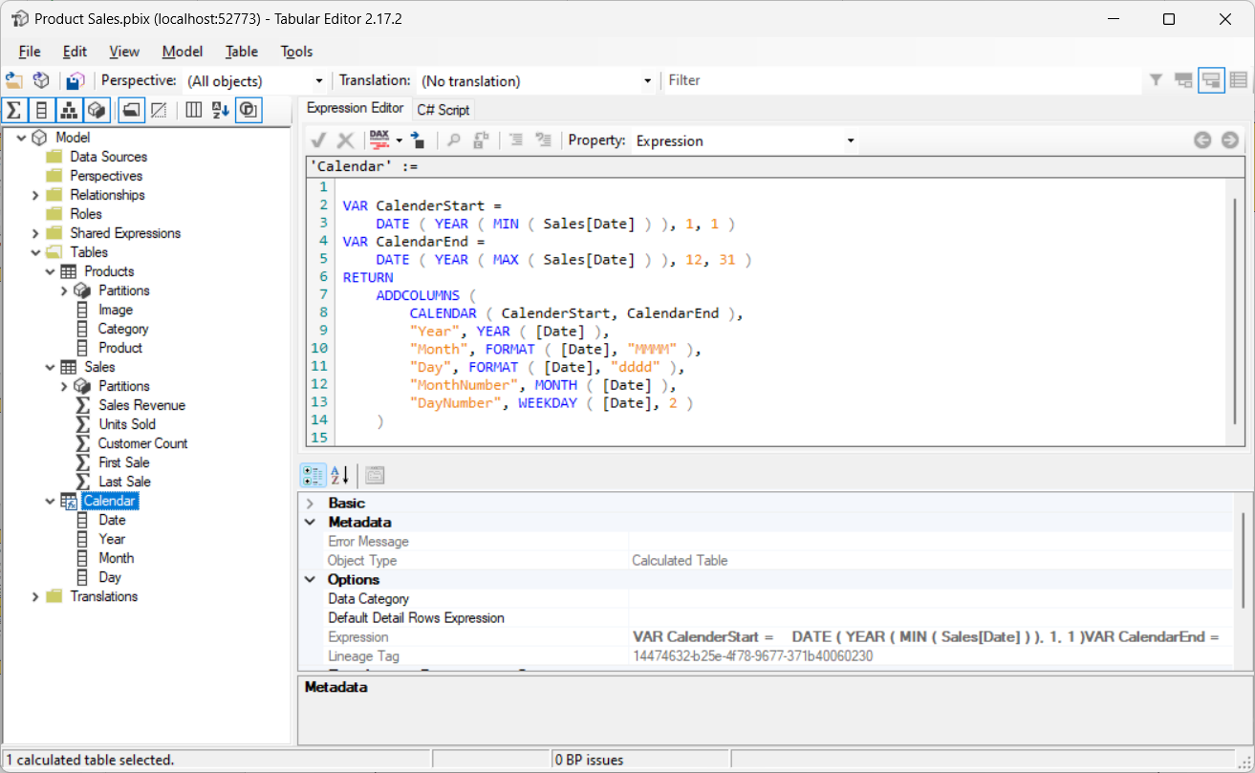
Working with Tabular Editor 2
Tabular Editor provides advanced data modeling not possible in Power BI Desktop
User can add advanced modeling features by hand
User can automate adding advanced modeling features using advanced scripting
Download version 2 from https://github.com/otykier/TabularEditor/

Slide 6
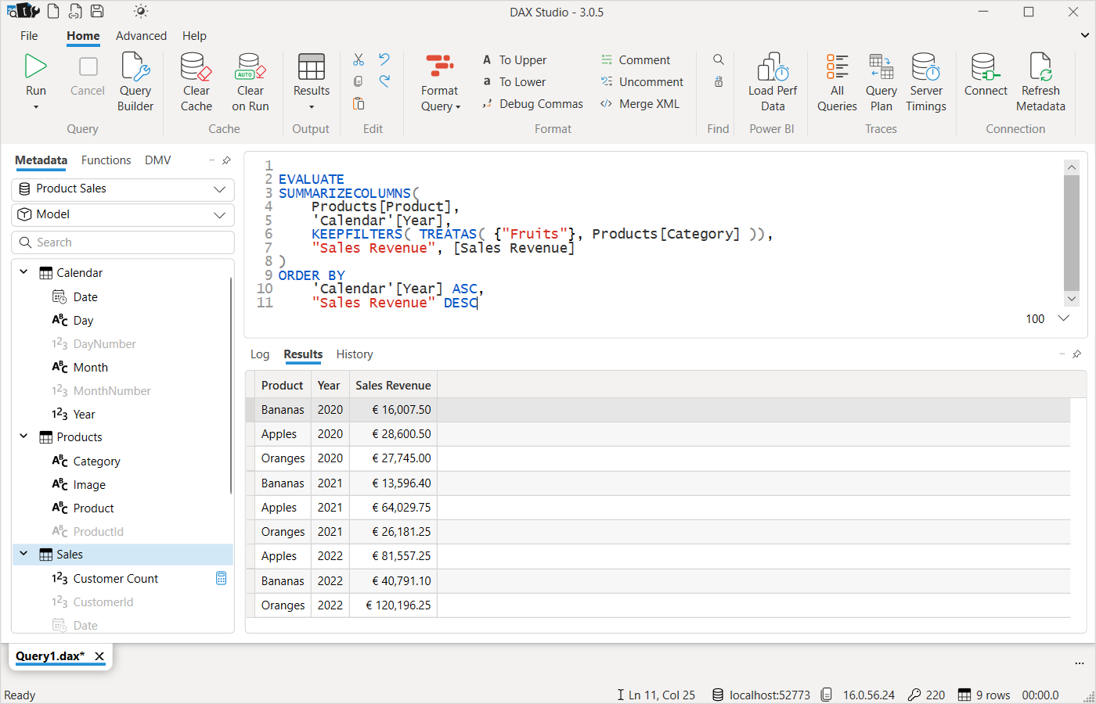
Working with DAX Studio
DAX Studio provides advanced data modeling tool to write and test DAX queries
Powerful tool for monitoring and optimizing query performance
Download from https://daxstudio.org/

Slide 7
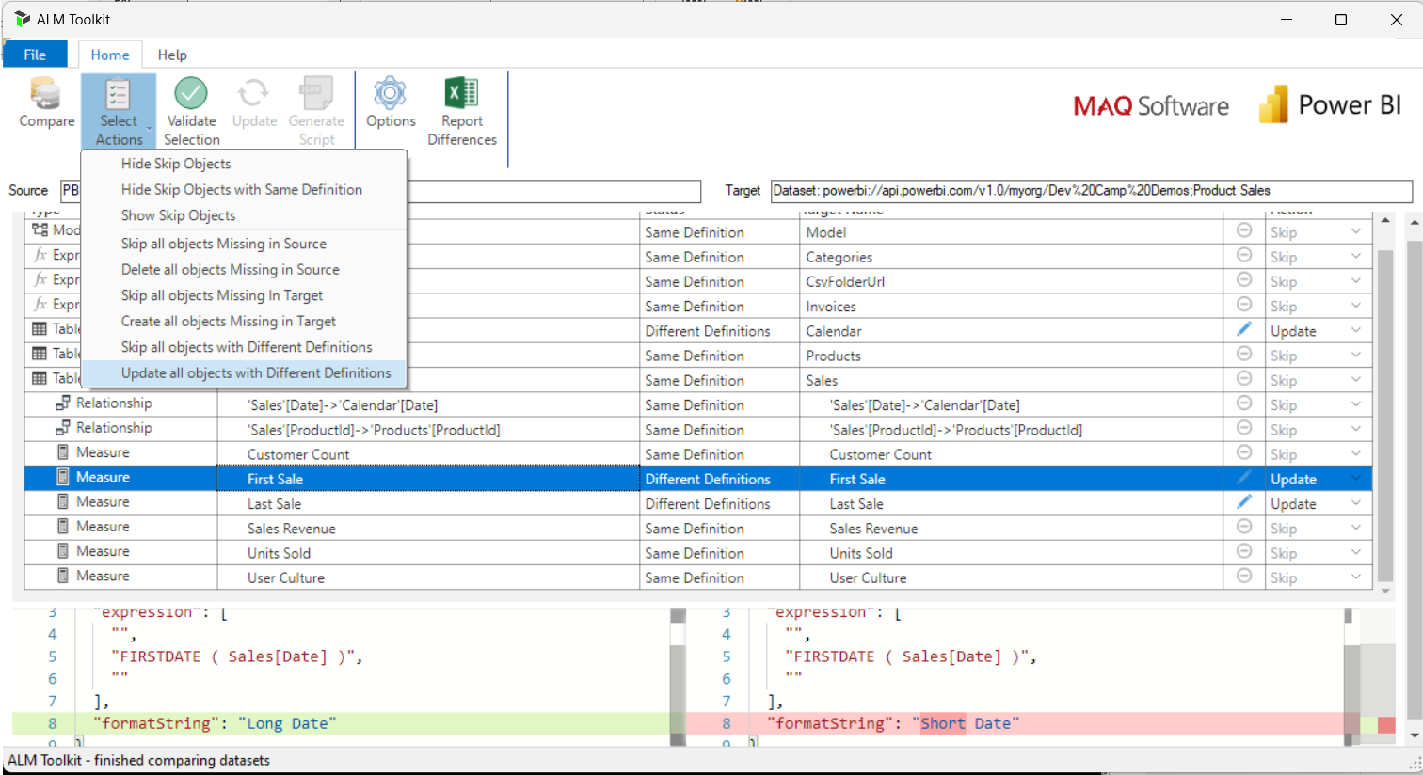
Working with ALM Toolkit
ALM Toolkit provides tool for deploying and updating datasets
Allows user to compare datasets in Power BI Desktop and Power BI Service
Provides support to push new objects and updates to production datasets
Download from http://alm-toolkit.com/

Slide 8
Connection Models for External Tools
There are two primary connection models for an external tool
Connect to datasets running locally in Power BI Desktop loaded from PBIX file
Connect to datasets running remotely in the Power BI Service
Considerations
Using connection model #1 allows you to check PBIX file with updates into source control
Using connection model #2 prevents ability to download dataset as PBIX file
Using connection model #2 provides many advanced ALM capabilities
Tabular
Editor
Power BI Desktop
Tabular
Editor
Power BI Service
PBIX Project File
Premium Workspace
Dataset
XMLA
Endpoint
Dataset
Your Custom External Tool
Your Custom External Tool
Local Dataset
ALM Toolkit
Production Dataset
Push Dataset Updates into Production

Slide 9
Agenda
Developing External Tools for Power BI Desktop
Exploring Dev Camp External Tool Demo App
Programming the Tabular Object Model (TOM)
Adding Productivity Features to an External Tool
Extending Translations Builder

Slide 10
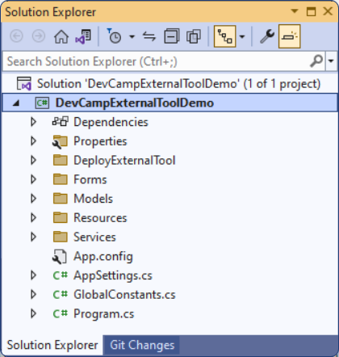
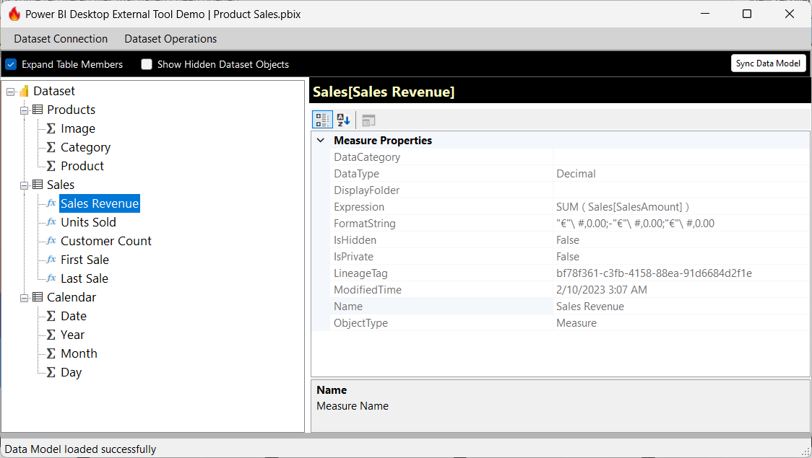
The DevCampExternalToolDemo Project
DevCampExternalToolDemo project demonstrates simple external tool
Created using Visual Studio 2022, C#, .NET 6 and Windows Forms
You can use it as starter project for developing your own external tool
You can use it as a learning tool to get up the learning curve with external tool development
Download from https://github.com/PowerBiDevCamp/DevCampExternalToolDemo

Slide 11
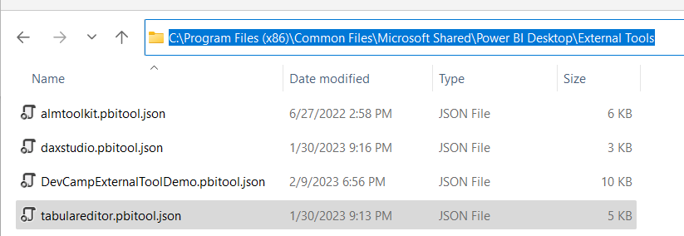
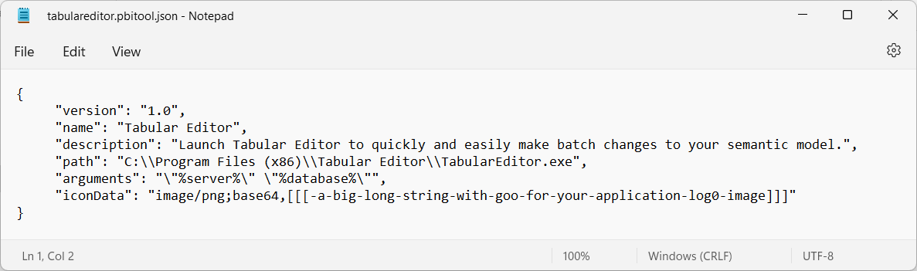
External Tool Deployment
External Tools deployed by copying JSON file to External Tools folder
Deployment file must be named with pbitool.json extension such as tabulareditor.pbi.json
File copied to C:\Program Files (x86)\Common Files\Microsoft Shared\Power BI Desktop\External Tools
pbi.json file for external tool tracks name, EXE path, arguments and icon data

Slide 12
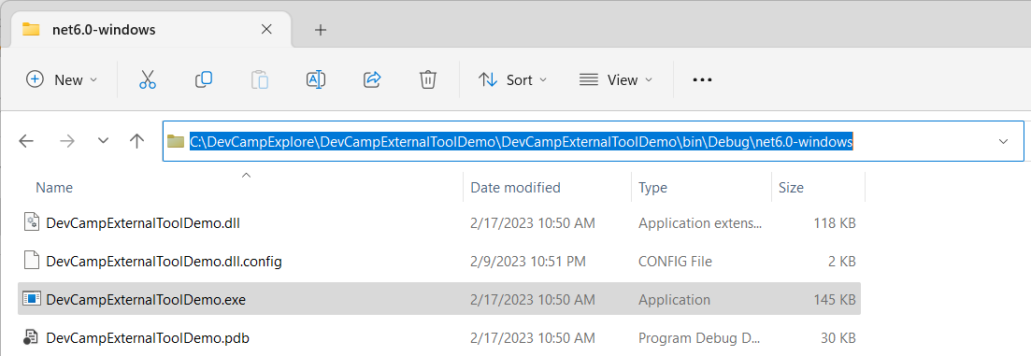
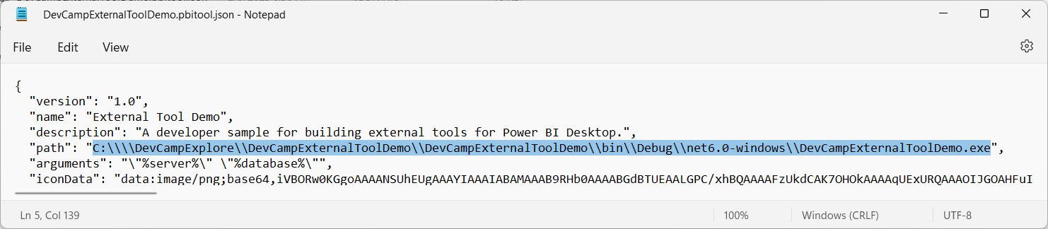
External Tool Deployment for Development
Developer can update pbi.json file for development-time usage
Visual Studio builds application’s EXE debug version in local bin\Debug folder
Update pbi.json file to point to EXE in in bin\Debug file to run tool in Visual Studio debugger

Slide 13
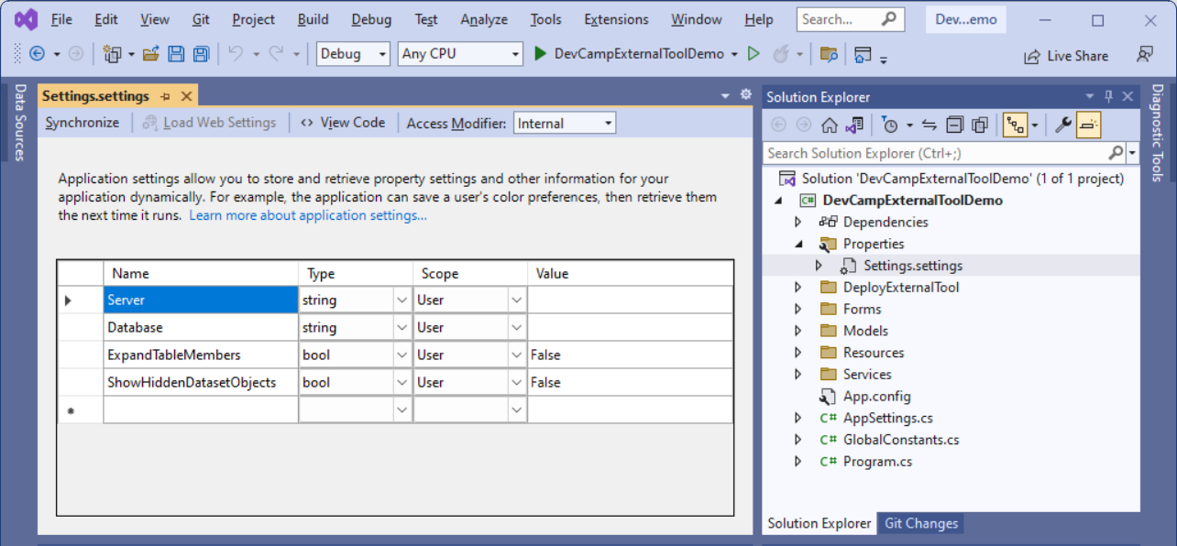
Tracking User Setings
dccc

Slide 14
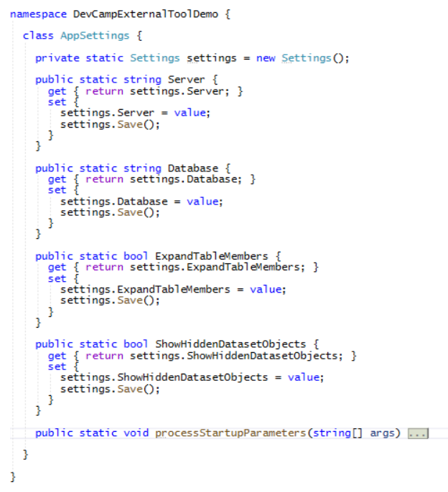

Slide 15
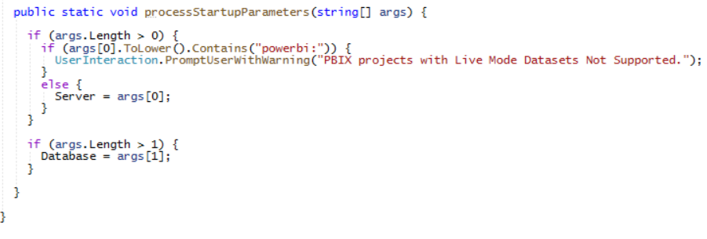
Start Up Parameters

Slide 16
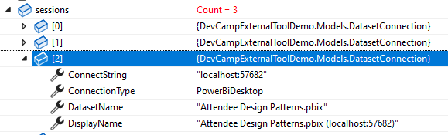
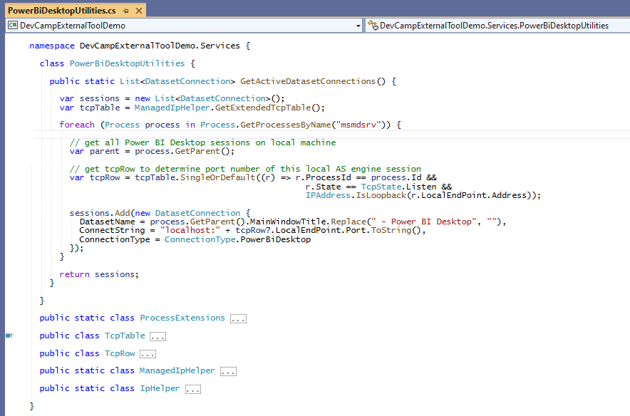
PowerBiDesktopUtilities

Slide 17
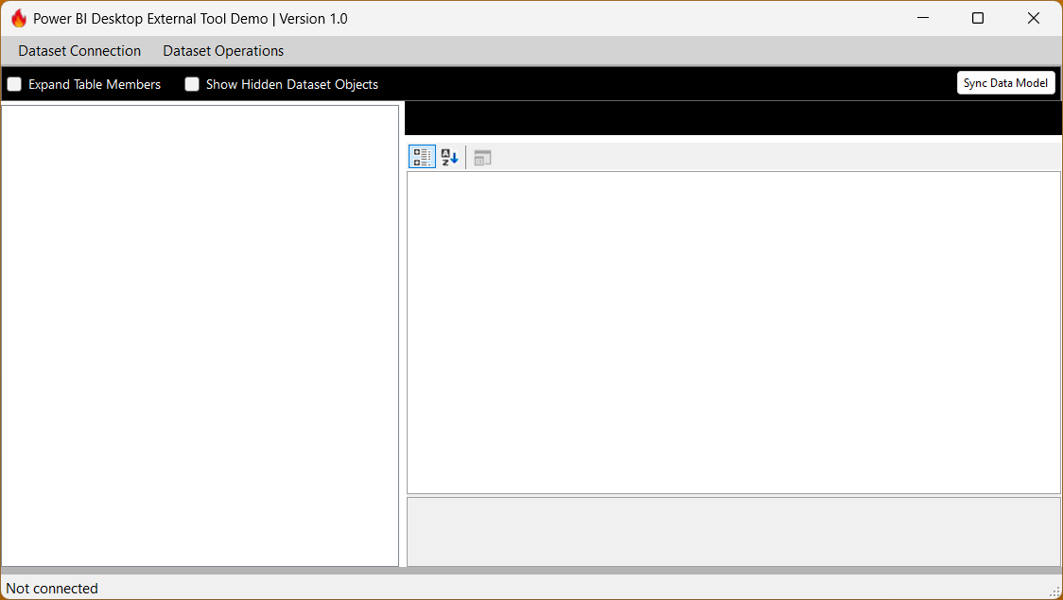
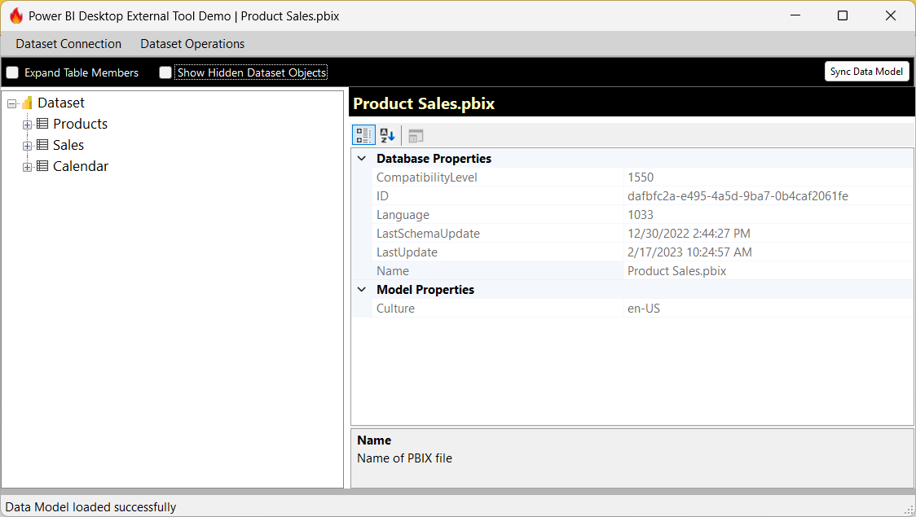
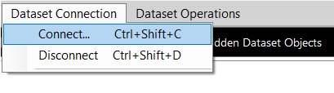
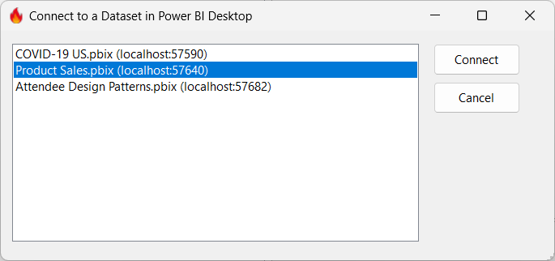

Slide 18
Agenda
Developing External Tools for Power BI Desktop
Programming the Tabular Object Model (TOM)
Adding Productivity Features to an External Tool
Extending Translations Builder

Slide 19
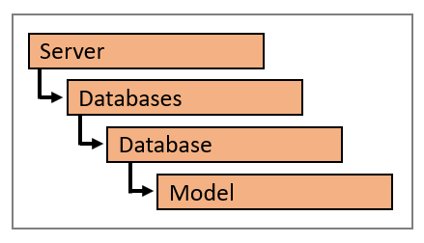
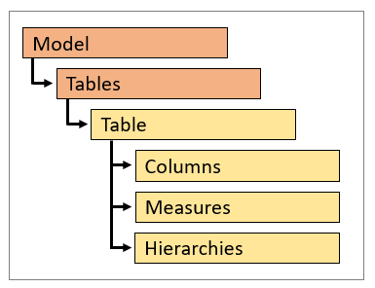
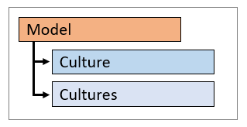
Tabular Object Model (TOM)
TOM is extension of Analysis Management Object (AMO) client library
TOM supports programming against Power BI datasets using XMLA protocol
Power BI dataset represented in TOM with a Database object
Data model inside dataset represented in TOM with Model object
Model object provides access to dataset objects
TOM provides support for adding/managing metadata translations
Dataset object types supporting localization include Table, Column, Measure and Hierarchy
Dataset object translation properties include Caption, Description and DisplayFolder
Model object contains Culture property and Cultures collection

Slide 20
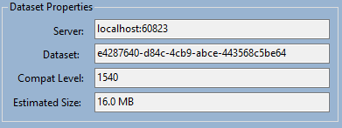
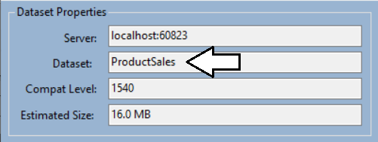
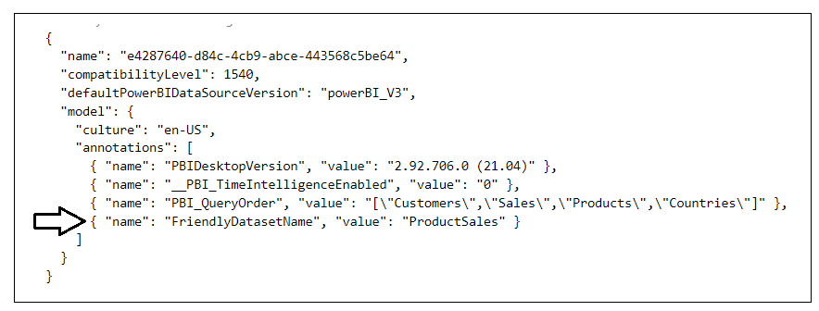
Understanding Annotations
Annotations provide ability to store custom properties in dataset definition
Can be used to storing any type of custom metadata
Used in TranslationsBuilder to store friendly name for dataset
Annotation stored inside dataset definition

Slide 21
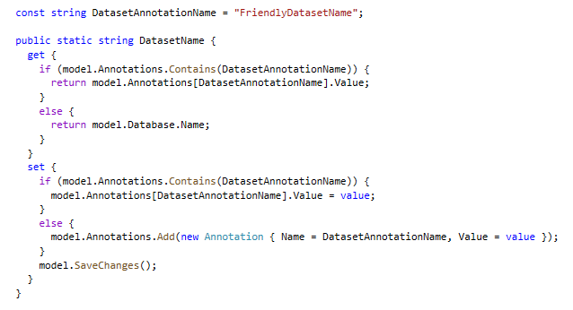
Programming Annotations

Slide 22
Agenda
Developing External Tools for Power BI Desktop
Programming the Tabular Object Model (TOM)
Adding Productivity Features to an External Tool
Extending Translations Builder

Slide 23
Export Data Model as Model.bim

Slide 24
Generate Dataset Model Schema Report

Slide 25
Updating Format String for All DateTime Columns

Slide 26
Format DAX Expressions using SQLBI API
Uses annotations to track which DAX expressions have already been formatted

Slide 27
Create Calendar Table from Date Column

Slide 28
Generate Translated Report Labels
Uses AdomdClient to execute query against dataset and return JSON resultset

Slide 29
Create and Manage RLS Roles

Slide 30
Agenda
Developing External Tools for Power BI Desktop
Programming the Tabular Object Model (TOM)
Adding Productivity Features to an External Tool
Extending Translations Builder

Slide 31

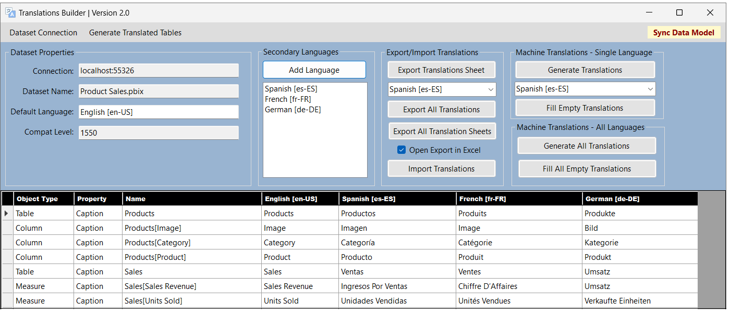
Working with Metadata Translations
Power BI Desktop does not expose metadata translations
It provides no capability to view, add or edit metadata translations
What are your options for working with metadata translations?
Use Tabular Editor to manually add and edit translations
Write scripts for Tabular Editor
Develop custom application with C# and Tabular Object Model (TOM)
Use Translations Builder – it was designed specifically to play this role

Slide 32
Translations Builder 2.0
Translations Builder is tool designed for content creators using Power BI Desktop
Content creators can use this tools to add multi-language support to PBIX project files
Provides support for working with (1) metadata translations and (2) report label translations

Slide 33
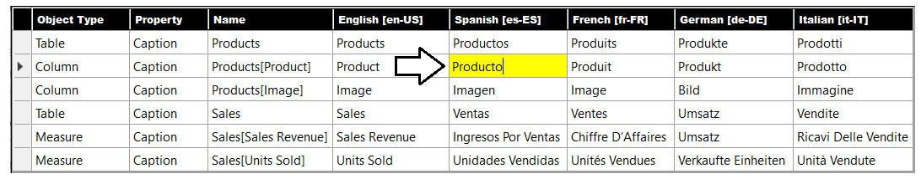
Working in the Translation Grid
Translations Builder user experience centers around translation grid
Abstracts away detail of read/writing object metadata to/from dataset
Allows user to view, add and update metadata translations using a two-dimensional grid
Provides simplified user editing experience similar to Microsoft Excel
Translations Builder
Power BI Dataset

Slide 34
Adding Metadata Translations
You can add dataset translations into PBIX project file
You can add/manage dataset translations with datasets running in Power BI Service
Tabular
Editor
Power BI Desktop
PBIX Project File
Dataset
Custom Code using TOM
Tabular
Editor
Power BI Service
Premium Workspace
XMLA
Endpoint
Dataset
Custom Code using TOM

Slide 35
Summary
Developing External Tools for Power BI Desktop
Programming the Tabular Object Model (TOM)
Adding Productivity Features to an External Tool
Extending Translations Builder

Slide 37
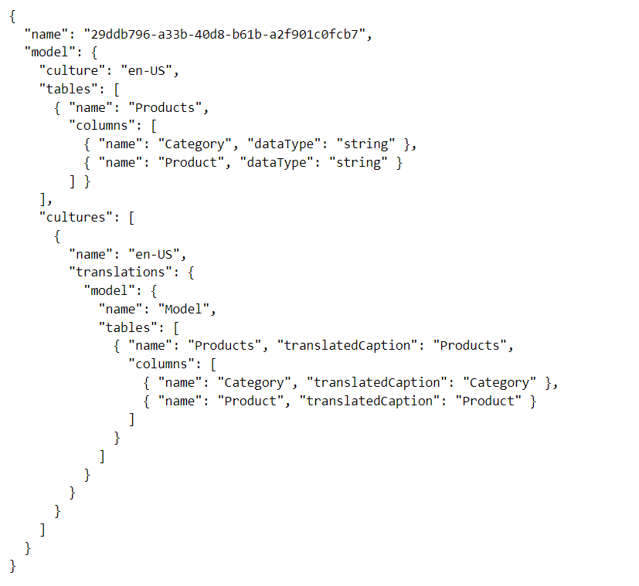
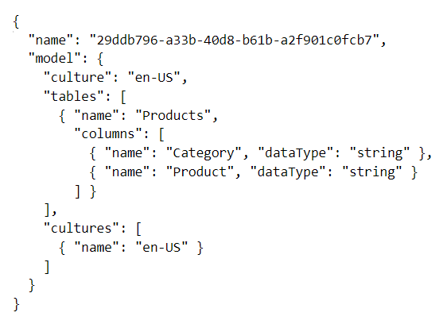
Adding Metadata Translations
When you create a new PBIX project…
It has a default culture (en-US) but that culture contains no metadata translations
You must add metadata translations for default culture
You must add secondary cultures and then add metadata translations to them
Model
Table
Column
Measure
Hierarchy
Cultures
Culture
Table
Column
Measure
Hierarchy

Slide 38
Connection Model for External Tools
xxxx
Local Desktop Setup on Windows PC
Your_External_Tool.exe
Power BI Desktop
Custom C# Code
Local Analysis Services Engine
Dataset
Tabular Object Model
localhost:55074
XMLA Endpoint
.NET 6 Runtime

Slide 39
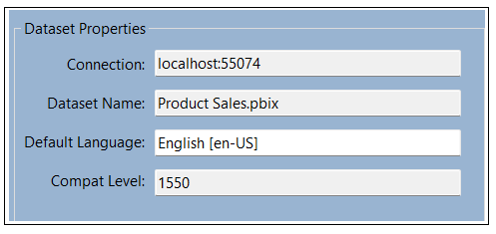
Launching Translations Builder
After installation, launch Translations Builder from External Tools tab
Translations Builder establishes connection back to dataset running in local AAS engine
Local Desktop Setup on Windows PC
Translations Builder
Power BI Desktop
Custom C# Code
Local Analysis Services Engine
Dataset
Tabular Object Model
localhost:55074
XMLA Endpoint
.NET Runtime

